Slide 1

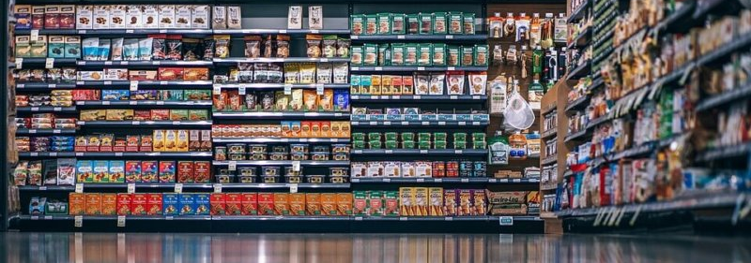
BUSINESS DATABASE FOR SUPERMARKET SHELF
Student Names: Zequn Che, Hong Zhu

Slide 2
BASIC MANAGEMENT OF SUPERMARKET
Add Products
Clear Expired Products
Be Fast and Accurate

Slide 3
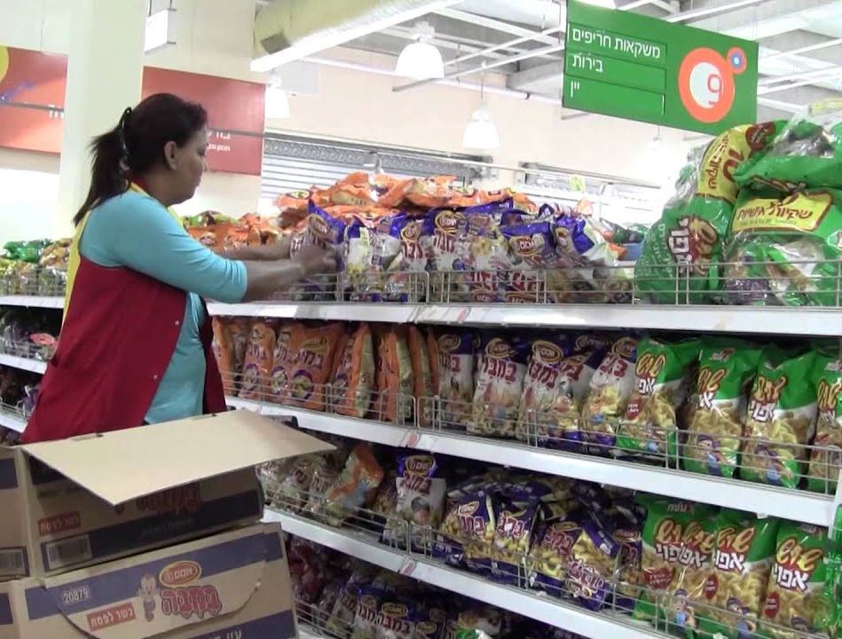
ADD PRODUCTS
When adding products, the manager should input the information of the products into the system of management, so that the supermarket could know and control the situation of the products on the shelves.

Slide 4
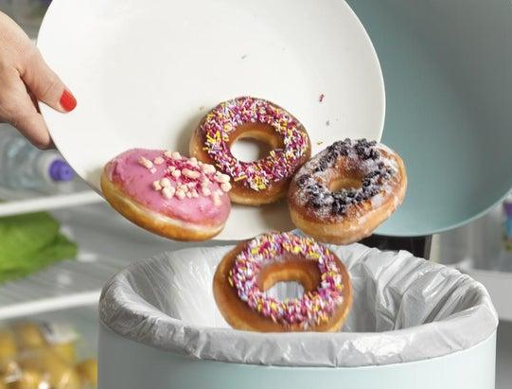
CLEAR EXPIRED PRODUCTS
Throw away the expired products in time to avoid selling them to the customers.
Before the expiration date, sell the products in lower prices.

Slide 5
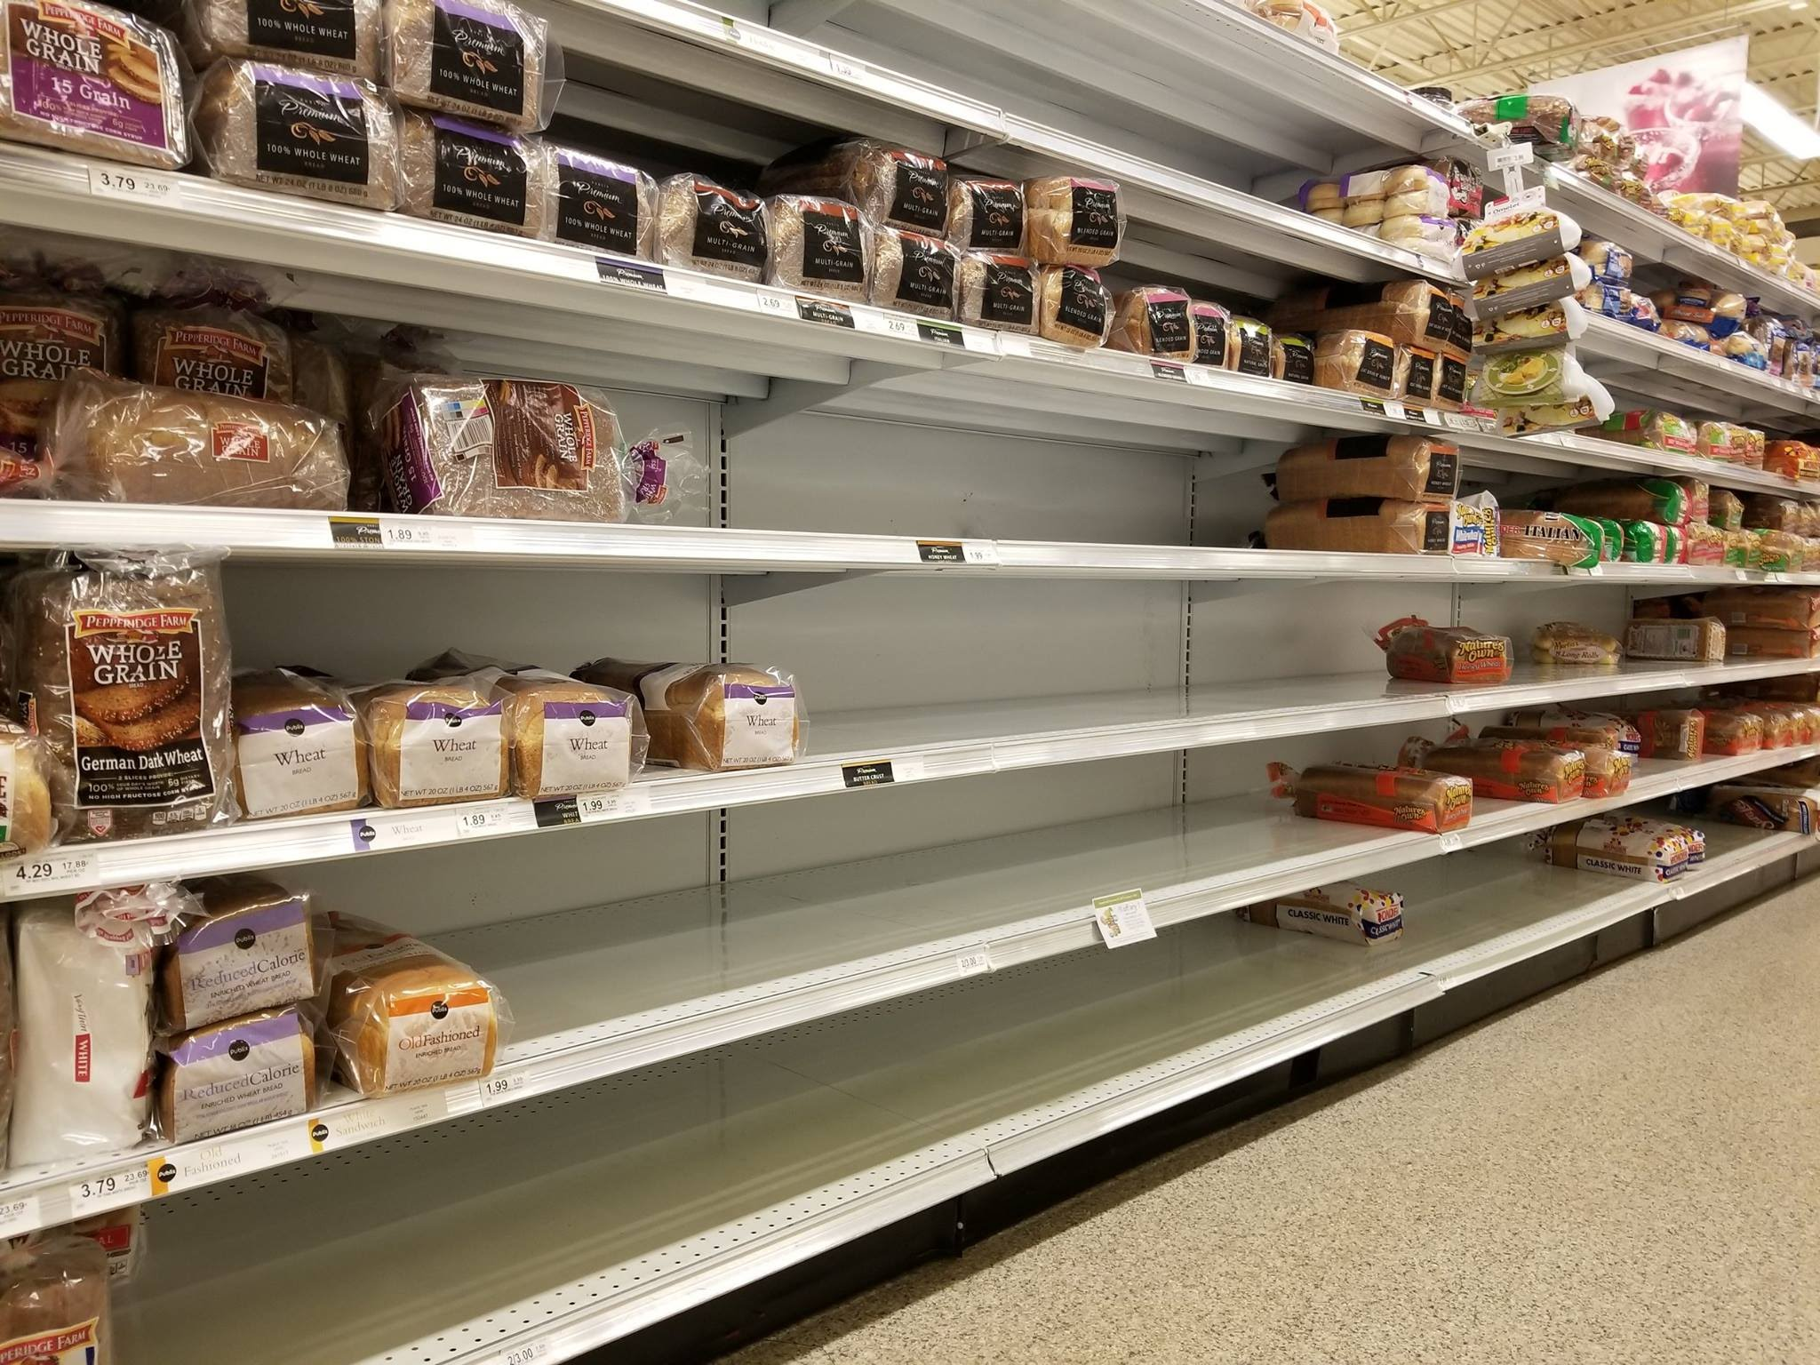
BE FAST AND ACCURATE
Do replenishment
prepare enough products in the storage

Slide 6
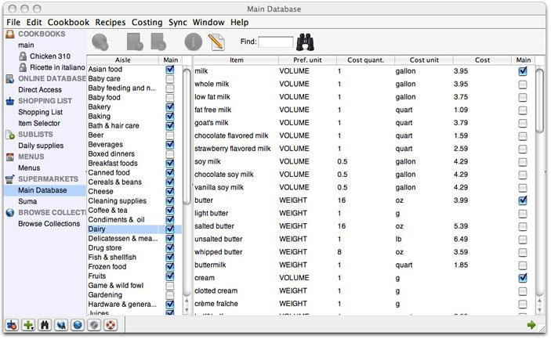
THE BUSINESS DATABASE
Detailed data of all the products
Easy to Find the products which are close to the expiration dates
Report the data for prediction and future plan making

Slide 7
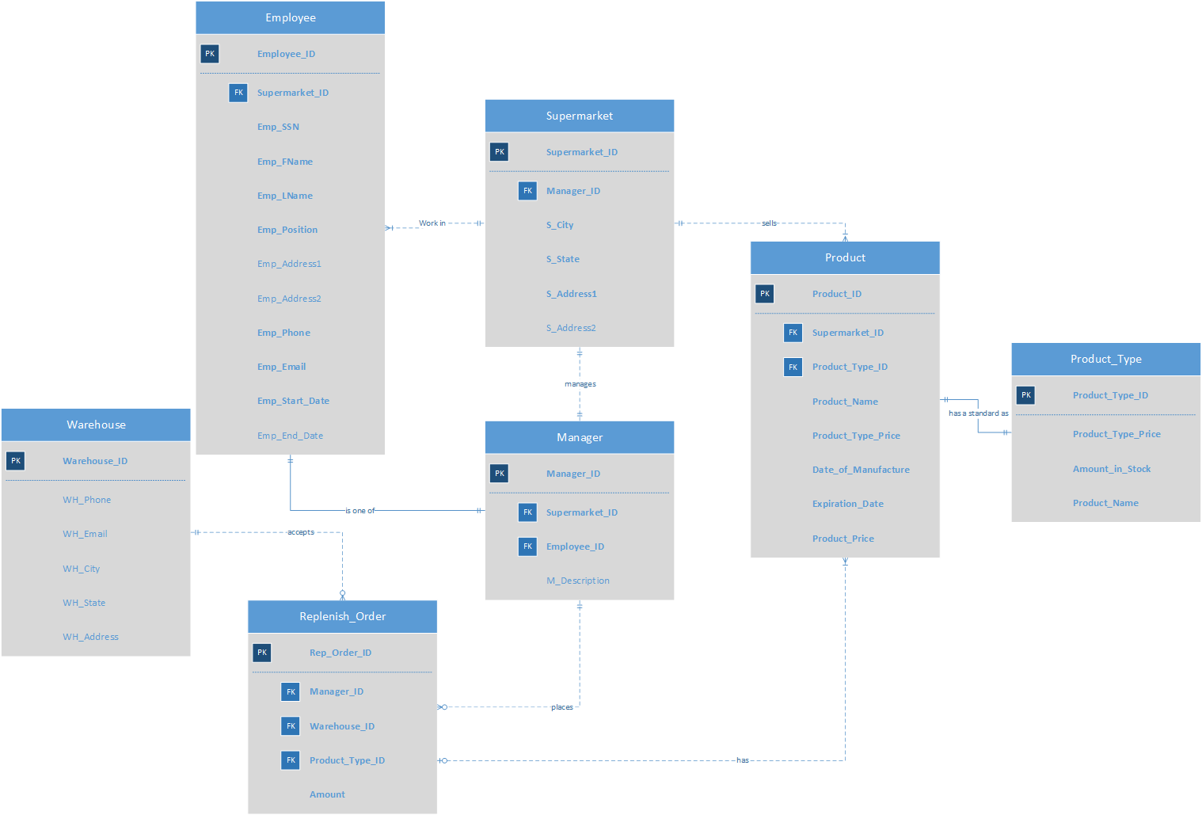
ENTITY RELATIONSHIP DIAGRAM

Slide 8
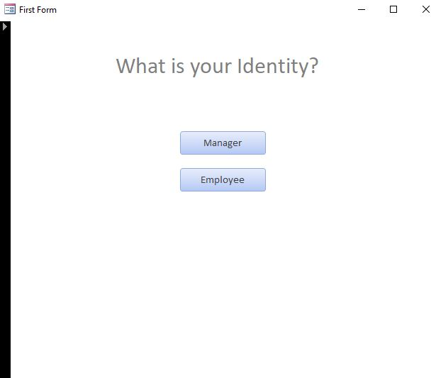
The first page of the system
Managers and Employees have different stages
Notes:
This is the first page of the system Managers and Employees have different stages

Slide 9
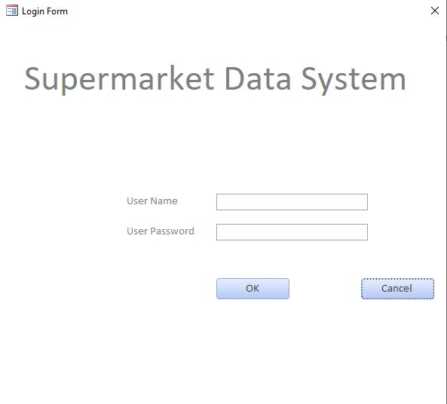
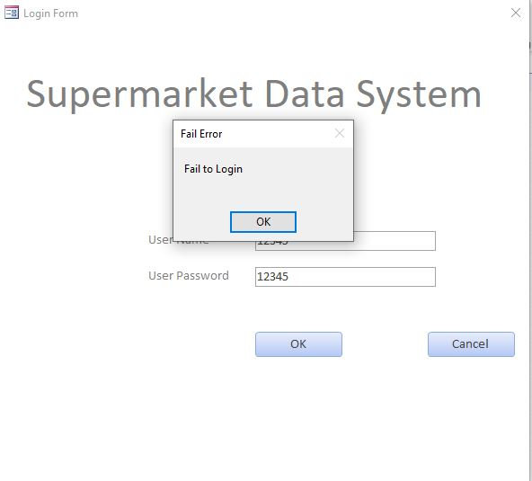
Login will be failed if the combination is wrong
Managers need their user Name and Password
to login the system

Slide 10
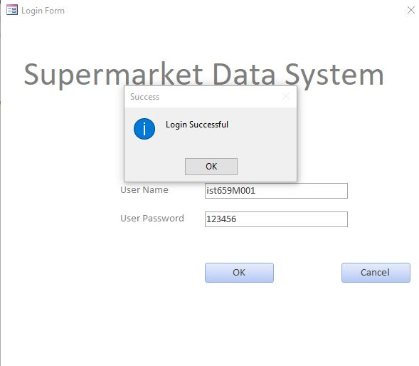


Slide 11
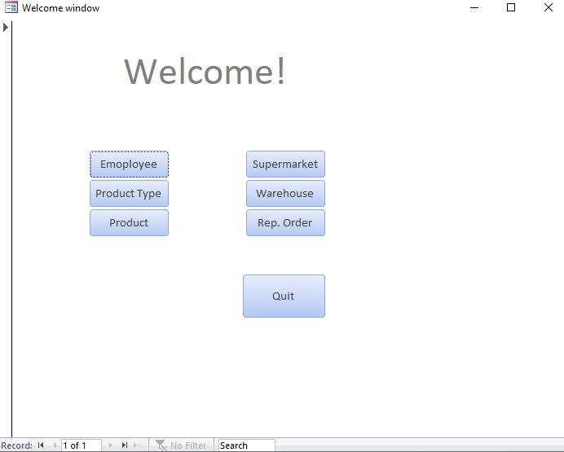
The homepage of a Manager
They can view 6 tables and edit them

Slide 12
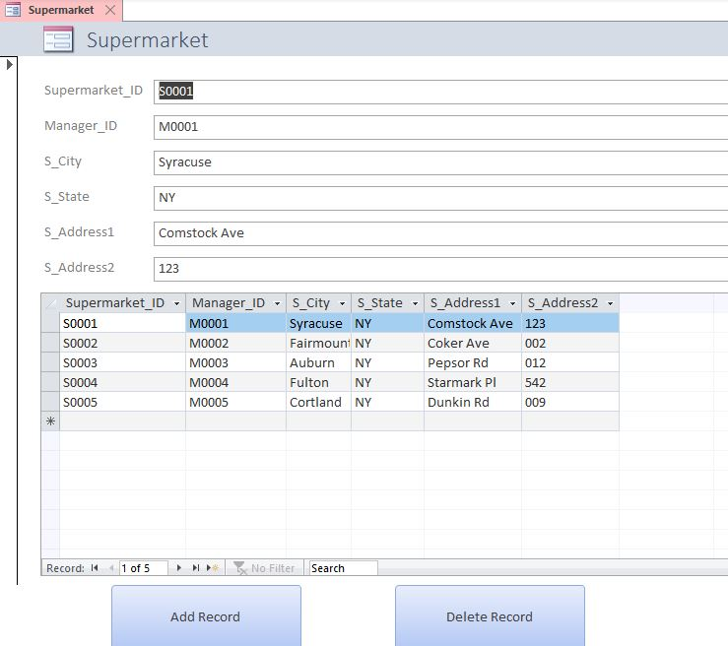

Slide 13
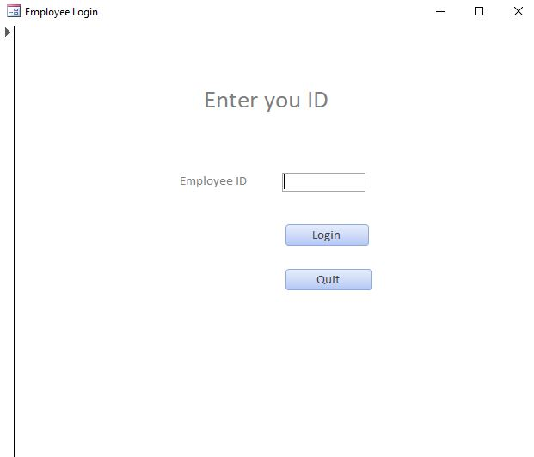
Login form of employees
They only need their Employee ID
(Read only)

Slide 14
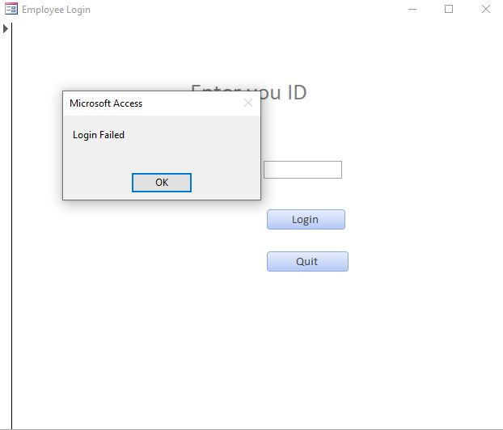
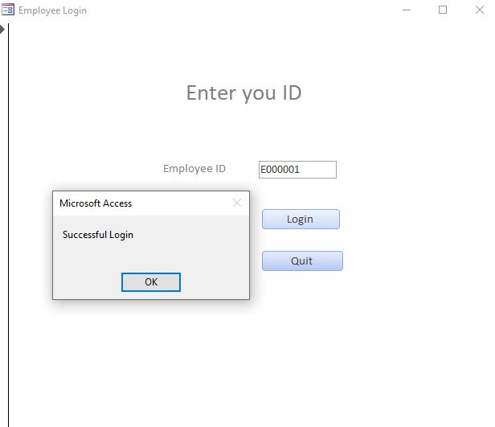

Slide 15
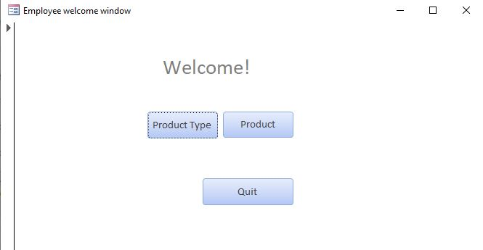
Homepage of Employee after login

Slide 16
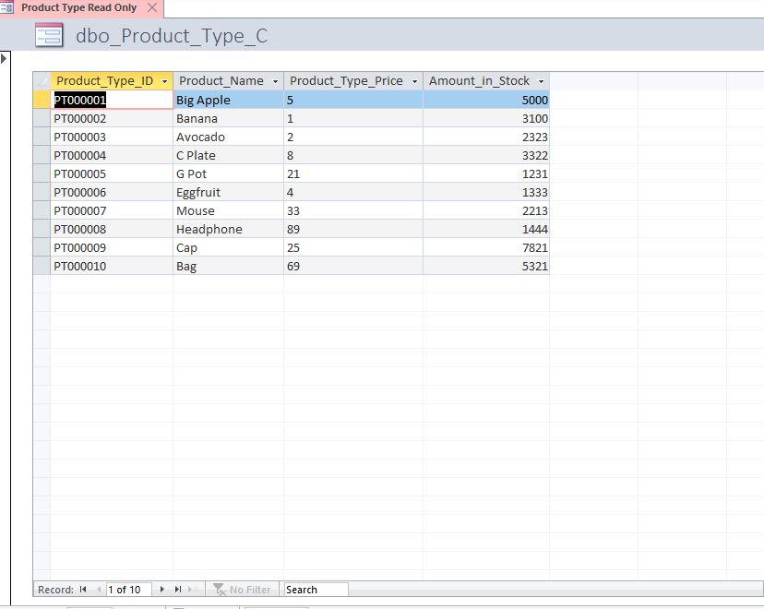
Employees’ way to see the tables
Read only

Slide 17
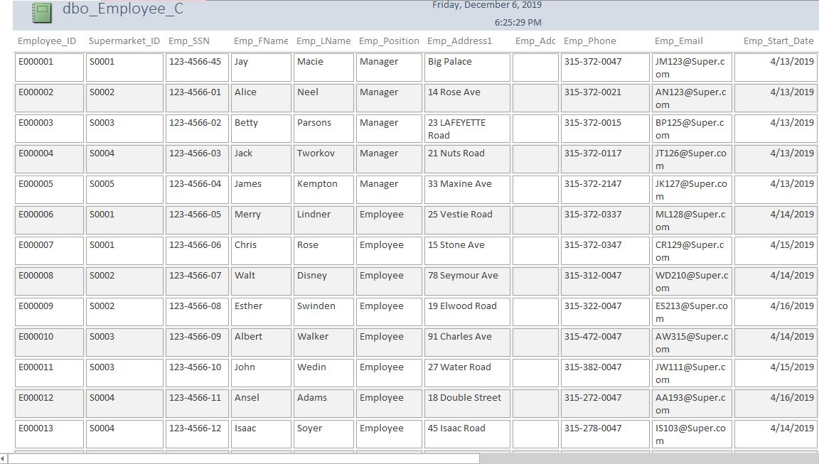

Slide 18
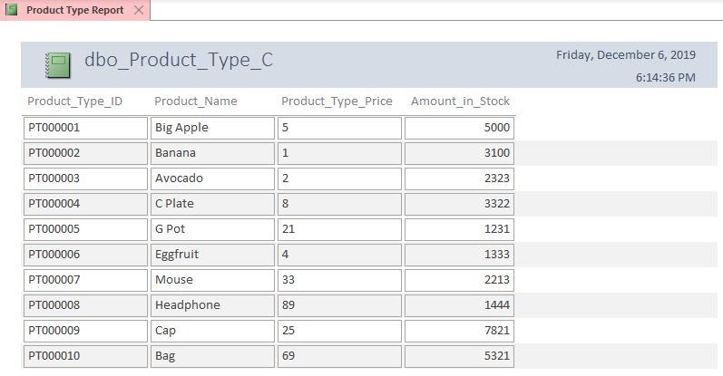

Slide 19
Thank you !

